Slide 1
Azure Service Bus, Your Gateway to a Whole New Way to Handle Integrations
Eric W. Cahoon
Principal CRM Solution Architect @ Crowe Horwath, LLP

Slide 2

Eric W. Cahoon Principal CRM Solution Architect for Crowe, LLP CRM Experience: 9 Years Development Experience: 20+ Years

Slide 3

Course Objectives
At the end of this course, you should be able to understand:
The problem space a Service Bus addresses
The fundamental concepts of Microsoft Azure Service Bus
How to provision an Azure Service Bus and interact with it through Microsoft Dynamics CRM

Slide 4

Course Agenda
Why we need a Service Bus?
What is the Azure Service Bus?
ASB Fundamentals (PubSub Model, Queues & Topics, Pros & Cons)
Integrating CRM and ASB
Creating Service Bus on Microsoft Azure
Integrating CRM to Service Bus
Posting Data to Service Bus from CRM
Verifying data on Azure Portal
Reading data (messages) from Azure
Helpful Links

Slide 5
Why a Service Bus

Slide 6
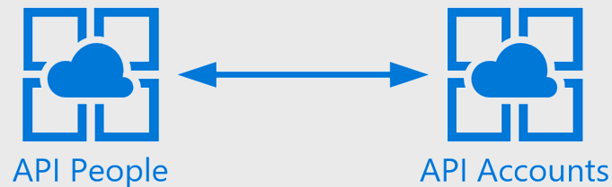
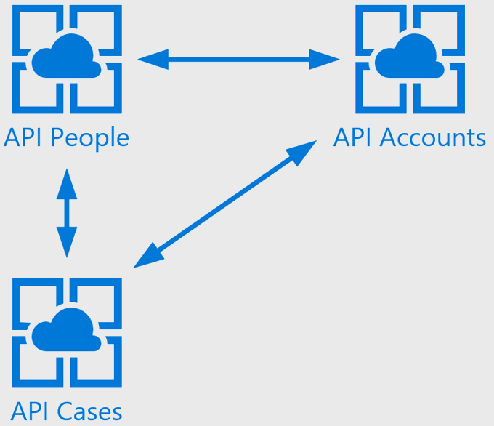
Most integrations start out nice and simple.
But they grow and introduce complexity

Slide 7
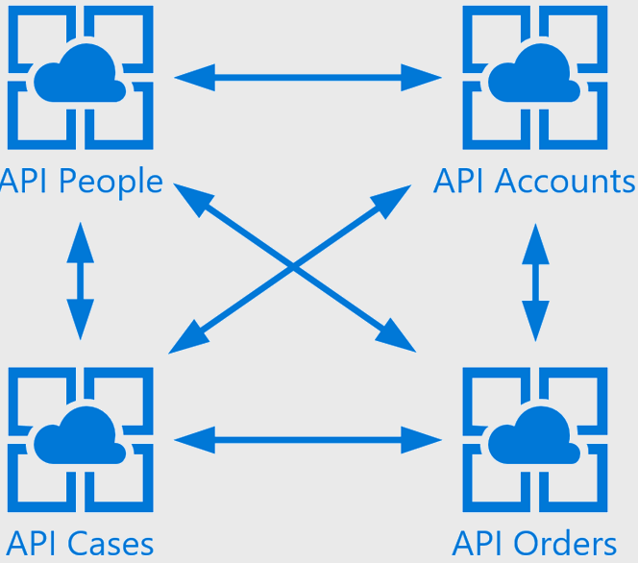
Pretty soon, our integrations grow to a level that is difficult to manage, and each new integration points results in an exponential growth of complexity and potential points of failure.

Slide 8
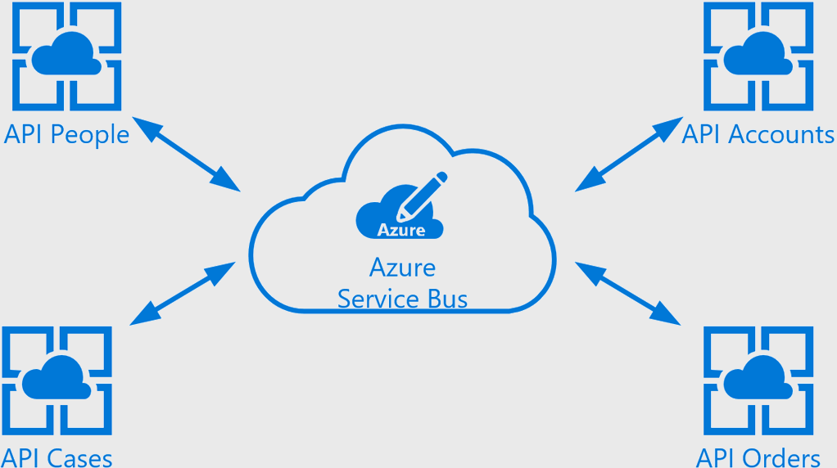
One way to reduce the complexity and introduce fault tolerance is to introduce a middle man (i.e. service bus) to handle orchestrating the communication between the services.

Slide 9
What is Microsoft Azure Service Bus

Slide 10
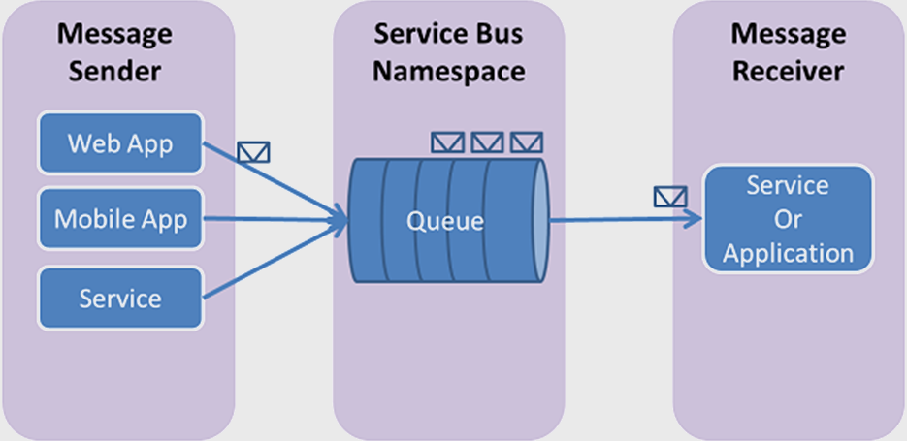
Microsoft Azure Service Bus (MSB) is a reliable information delivery service, which makes the communication easier between applications. When two or more parties want to communicate each other they need a facilitator, MSB plays the role of facilitator to communicate between the applications.

Slide 11
ASB Features
Scalability
Schedule Deliver
Duplicate Detection
Sessions
Forward To
Actions
Transaction
Ordering
Filtering
On Message Events
Fault Tolerance

Slide 12
The PubSub Model

Slide 13



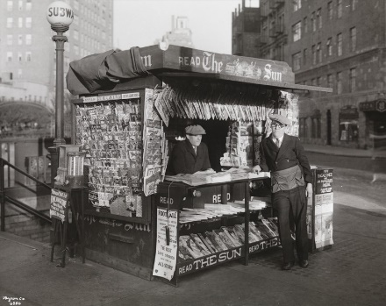
PubSub is a messaging pattern where senders of messages, called publishers, do not program the messages to be sent directly to specific receivers, called subscribers, but instead categorize published messages into classes without knowledge of which subscribers, if any, there may be. Similarly, subscribers express interest in one or more classes and only receive messages that are of interest, without knowledge of which publishers, if any, there are
Notes:
Let’s use an analogy to help visualize the role a service bus plays. Image we are a newspaper company (#1) and we have many subscribers (#2) to our newspaper. Now we could create a relationship with each individual subscribe and mail them their news paper each day or the subscriber could come to our office each day to pick their paper up. Now that’s not very effective, but in a peer to peer integration pattern that’s roughly what’s being done. So what could we do to be more effective?
Well, we could form relationships with a handful of newspaper people (#3) whom buy the paper from us and then allow those newspaper delivery people to handle the relationship with the subscriber and ensuring the subscriber gets their newspaper. Or we could form a relationship with a magazine stand (#4) who then buys the papers and sets them out for the subscribers to purchase.
In either case we are abstracting away the relationship between us (The Publisher) and people consuming our newspaper (The Subscribers)
So now for the long, boring definition here you go

Slide 14
Common Use Cases
Financial Services
Inter-Bank Transfer
Logistic
Order Processing
Insurance
Order fulfillment & Trading
Settlement
eCommerce
Delivery Notification
Claims Processing
Risk Modeling
Regulatory Filling

Slide 15
Queues & Topics

Slide 16
Queues
1st in 1st Out (FIFO) handling of messages
Use Cases:
Order Processing, IOT Telemetry
Topics
One to Many Communication of message
Use Cases:
Broadcast Messaging, Async Processing such as Loan Underwriting (Think QuickenLoans)
Notes:
Queues:
Queues offer First In, First Out (FIFO) message delivery to one or more competing consumers. That is, messages are typically expected to be received and processed by the receivers in the order in which they were added to the queue, and each message is received and processed by only one message consumer. A key benefit of using queues is to achieve “temporal decoupling” of application components. In other words, the producers (senders) and consumers (receivers) do not have to be sending and receiving messages at the same time, because messages are stored durably in the queue. Furthermore, the producer does not have to wait for a reply from the consumer in order to continue to process and send messages.
Topics:
Provide a one-to-many form of communication, in a publish/subscribe pattern. Useful for scaling to very large numbers of recipients, each published message is made available to each subscription registered with the topic. Messages are sent to a topic and delivered to one or more associated subscriptions, depending on filter rules that can be set on a per-subscription basis. The subscriptions can use additional filters to restrict the messages that they want to receive. Messages are sent to a topic in the same way they are sent to a queue, but messages are not received from the topic directly. Instead, they are received from subscriptions. A topic subscription resembles a virtual queue that receives copies of the messages that are sent to the topic. Messages are received from a subscription identically to the way they are received from a queue.

Slide 17
Pros & Cons of a Service Bus

Slide 18
PROS | CONS
Loose coupling between systems | Troubleshooting Can Be More Difficult
Failover Support Is Built In | Overhead added by traversing the ESB (Critical to think like trading applications)
Easy to Scale
Built in Fault-tolerance and Load Balancing
Notes:
"temporal decoupling" of application components. In other words, the producers (senders) and consumers (receivers) do not have to be sending and receiving messages at the same time, because messages are stored durably in the queue

Slide 19
Any Questions?

Slide 20
Demo

Slide 21
Supported Integrations by D365

Slide 22
Queue
A queue contract provides a message queue in the cloud. With a queue contract, a listener doesn’t have to be actively listening for messages on the endpoint. For queues, there is a destructive read and a non-destructive read. A destructive read reads an available message from the queue and the message is removed. A non-destructive read doesn’t remove a message from the queue.
The type of queue supported by Microsoft Dynamics 365 is called a persistent queue. Persistent queues have a long but finite message availability duration that can be specified in code.
Topic
Similar to a queue except that one or more listeners can subscribe to receive messages from the topic.

Slide 23
One-way
A one-way contract requires an active listener. If there is no active listener on an endpoint, the post to the service bus fails. Microsoft Dynamics 365 will retry the post in exponentially larger and larger time spans until the asynchronous system job that is posting the request is eventually aborted and its status is set to “Failed.”
Two-way
A two-way contract is similar to a one-way contract except that a string value can be returned from the listener to the plug-in or custom workflow activity that initiated the post.
REST
A REST contract is similar to a two-way contract on a REST endpoint.

Slide 24
Walkthrough Integrating ASB with CRM

Slide 25
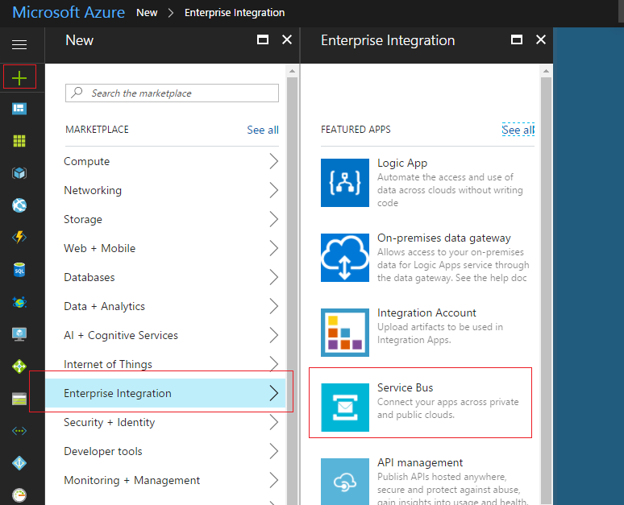
Provisioning a Service Bus can be created via the Azure portal or PowerShell
To provision through the Azure Portal, click the plus button and search for ‘Enterprise Integration’. Followed by clicking the ‘Service Bus’ option

Slide 26
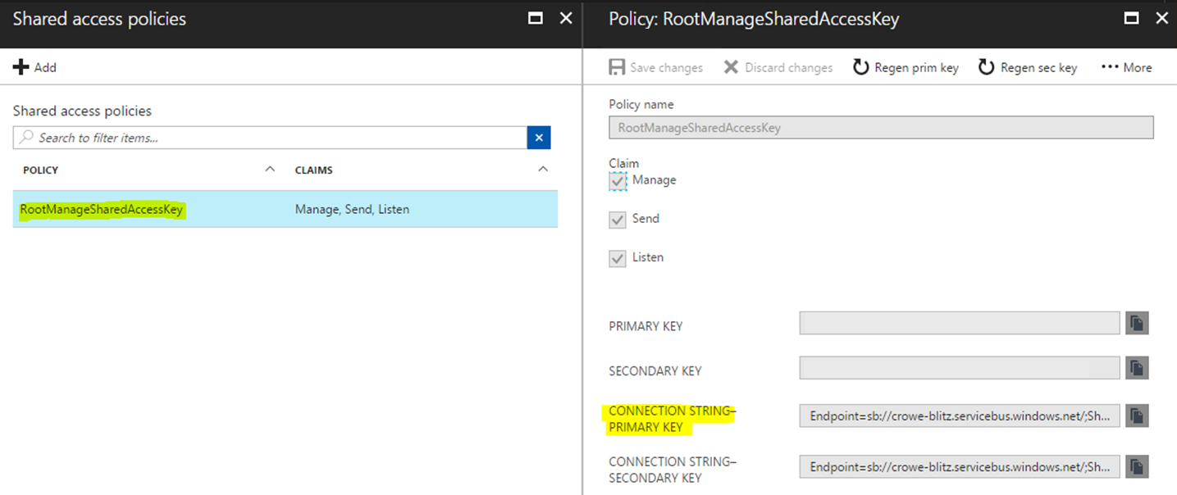
Once the service bus is provisioned, you’ll need to create a queue or topic and obtain the connection string to your ASB.
The connection string can be found from the namespace section of the Service Bus inside your Azure account, where you have defined shared access policies.

Slide 27
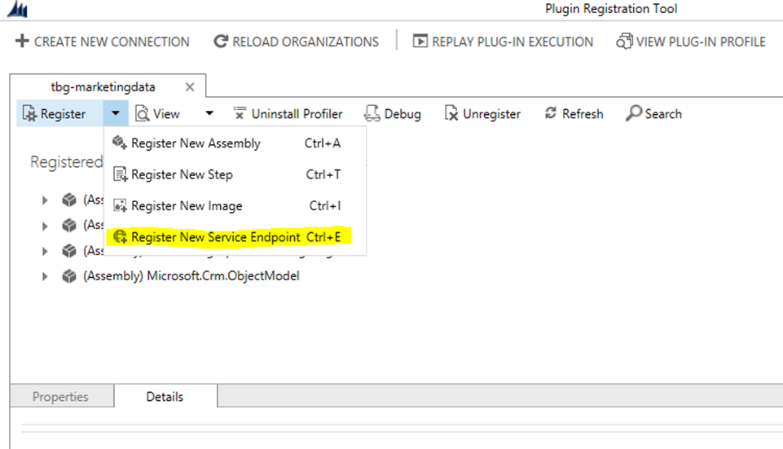
Endpoint Creation from Plugin Registration Tool:
Go to plug in registration tool and connect with any organization that you want to use for posting Dynamics 365 data to Service Bus queue.
Then go to Register New Service Endpoint

Slide 28
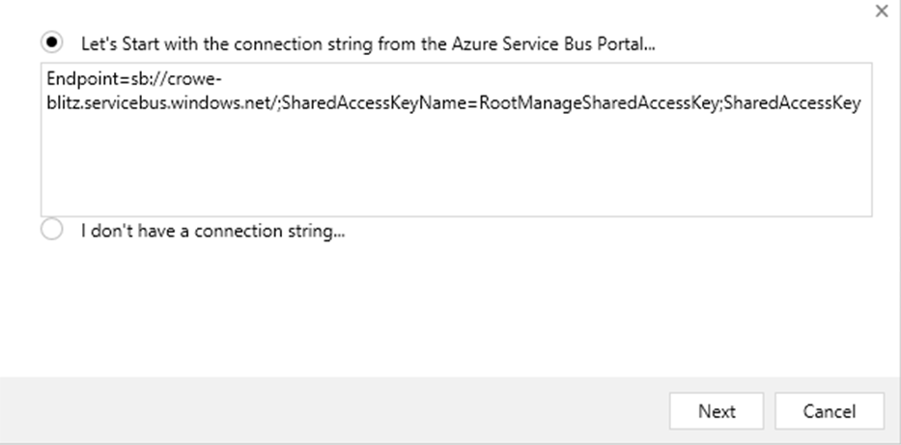
3. Enter the connection string in the window and click on next.

Slide 29
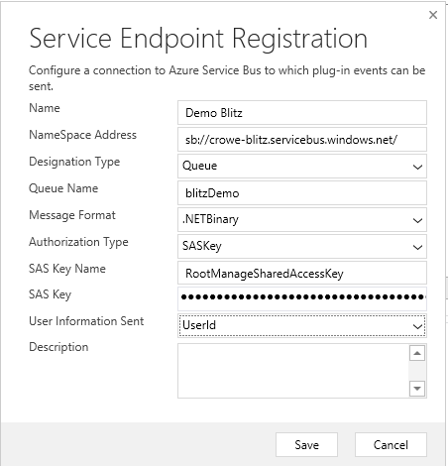
Following window will popup along with the prefilled information.
You can change the name of your
Endpoint.
It is mandatory to provide queue name to post massage to.
You can change the messaging
Format to JSON or XML also, which
can helpful for your listener
Applications.

Slide 30
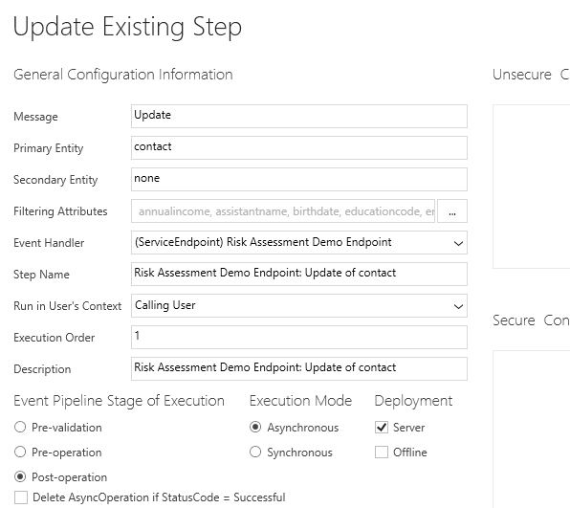
Once you click on save button you need to register steps in the similar way as we do in plugin registration and step creation by providing Message, Primary Entity and other information.
Note: These steps should be registered
in Async mode for improved
performance.

Slide 31
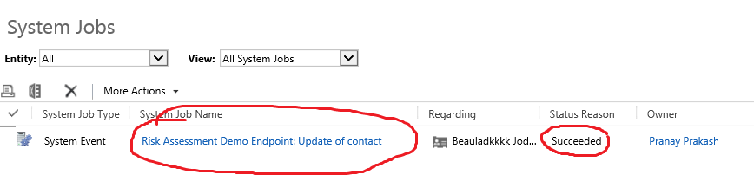
Login to CRM using an account that has edit permission to the entity used to post data to Service Bus from Dynamics 365
Open the entity record and modify the fields which you have used in filtered attributes during the steps creation of the plugin
Go to the Dynamics 365 Home > Settings > System Jobs
Find the record under the system jobs with Endpoint Name
Succeeded status means the data is posted to Service Bus.

Slide 32
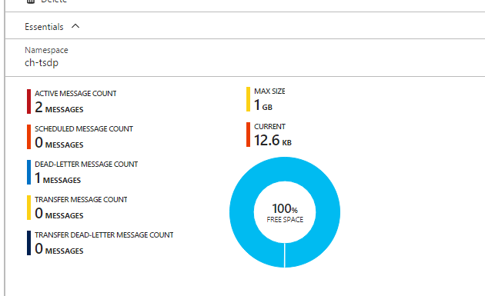
Data verification on Azure for data (messages) verification you can login to your azure portal and find the messages inside the queue you choose to post data to, alternatively you also can use ServiceBusExplorer ( a tool available on github).

Slide 33
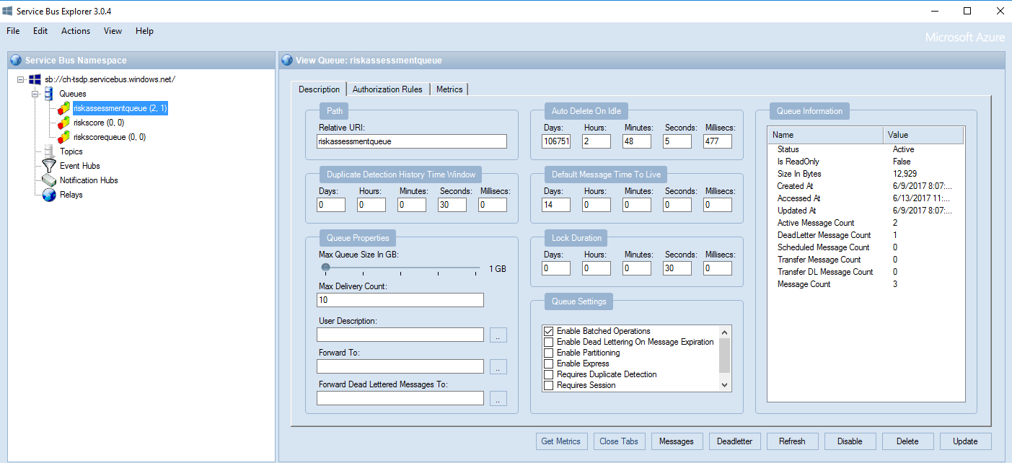
ServiceBusExplorer (a tool available on github).

Slide 34
Creating a Subscriber Client

Slide 35
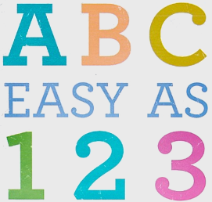
Connecting To ASB Is
Create a NamespaceManager
Check if Queue/Topic exists, create it if it doesn’t
Create Queue/Topic Client
Register Message Handler

Slide 36
Source Code Download
https://github.com/ericcahoon/Focus-2018-AzureServiceBus-Your-Gateway-To-A-Whole-New-Way-To-Handle-Integrations

Slide 37
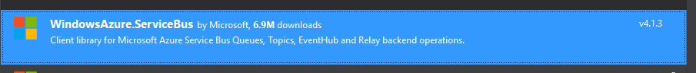
NuGet Packages Used

Slide 38
Helpful Links
A very thorough walk through of using CRM + Azure Service Bus
MSDN Azure Service Bus
Service Bus Explorer
https://www.youtube.com/watch?v=9A7SBvkH8yI
https://www.youtube.com/watch?v=jl0mhIM-1OA

Slide 39
Any Questions?

